Slide 1
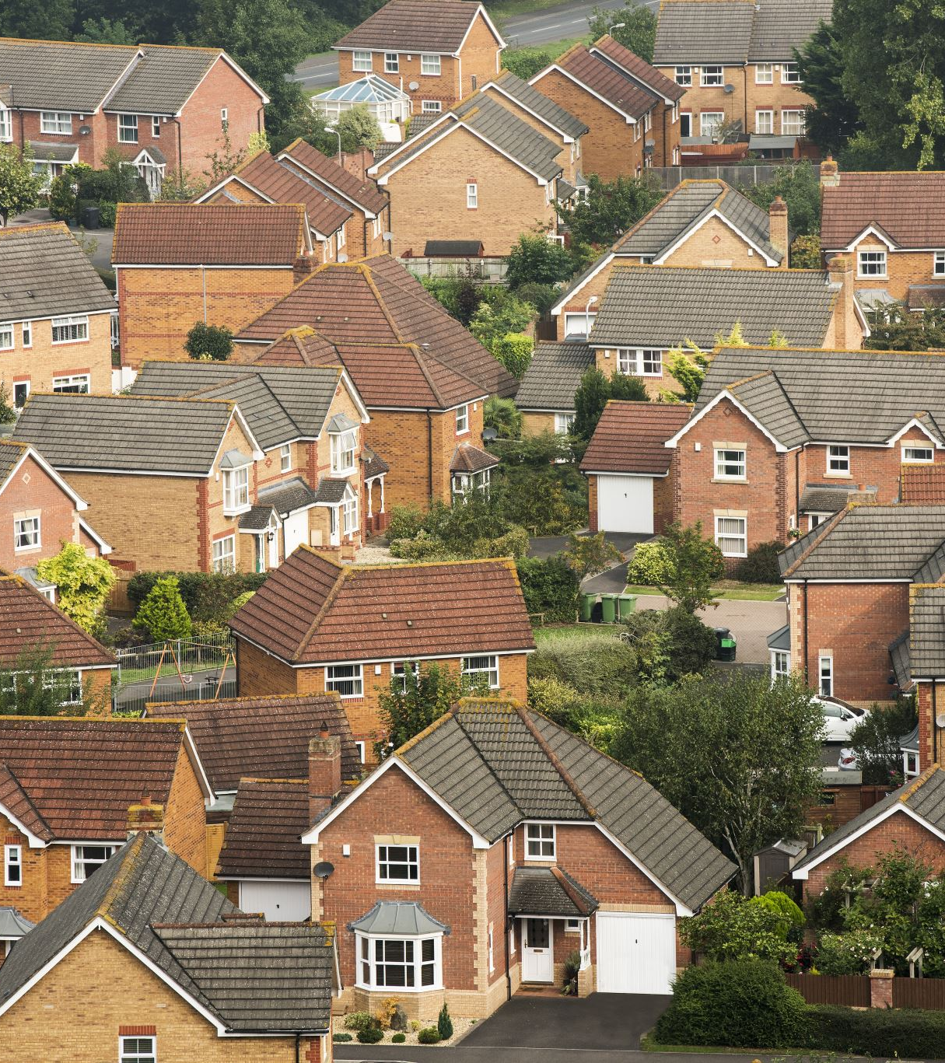
Predicting the Sale Price of Residential Properties
Joshua Ogden-Davis
Springboard Data Science Track
June 2023 Cohort
Capstone Project

Slide 2
Problem
Purchasing a home is not only one of the most important and consequential financial decisions in American life, it is a crucial part of the economy. Residential fixed investment and housing services together account for roughly 15-16% of the US GDP in 2023.*
However, both the official valuation of a residential property as well as the sale price negotiation process are subject to biases and sales tactics that can make navigating this decision treacherous and potentially unequitable, with profound consequences for individuals, families, and the economy as a whole.
Our task is to develop a machine learning model that will reliably estimate the expected sale price for residential properties based on objective features as a useful tool to reduce uncertainty for homebuyers and investors.
* https://eyeonhousing.org/2023/10/housing-share-of-gdp-remains-flat-in-the-third-quarter-of-2023/

Slide 3
What might affect a property’s price?
Features
Location
Condition
House size
Lot size
Number of rooms
Materials
Style
(etc)
Neighborhood
Zoning
Nearby amenities
Highway access
Alley access
(etc)
Year built
Year remodeled
Exterior quality
Interior quality
Finished interior %
(etc)

Slide 4
Data Source
The Ames Housing Dataset was compiled in 2011 by Dean De Cock from residential property sale information obtained through the Ames City Assessor’s Office regarding sales that took place between 2006 and 2010. It contains 79 features for 2,930 records, each record pertaining to a sale.
I will be using a subset of the Ames dataset that has been pre-divided into a training set (1,460 records) and a test set (1,459 records) by Kaggle.
* De Cock’s paper about the dataset can be found here: https://jse.amstat.org/v19n3/decock.pdf

Slide 5
Data Preparation
The features fall into one of three categories, requiring different preparation:
Continuous
Sizes (in square feet)
Quantities (ie, bedrooms)
Ordinal
Quality scores
Categorical
Neighborhood
Materials (wood, brick, etc)
Etc.
- Remove unreasonable values
- Remove outliers (>3.5std)
- Impute missing values
- Normalize
- Convert from strings to integers
- Impute missing values
- Normalize
- Standardize spellings
- Impute missing values
- Check for importance
- One-hot encode

Slide 6
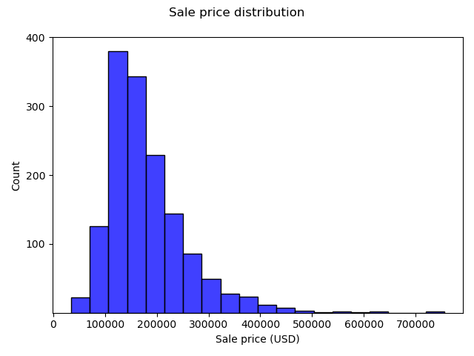
Target variable
- Right skew with outliers (expected)
- No left outliers

Slide 7
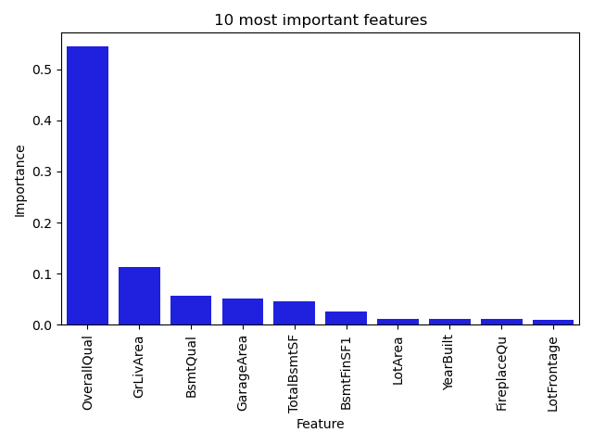
Feature importances
- Quality is by far the most important
- Most important features are quality
scores and size measurements

Slide 8
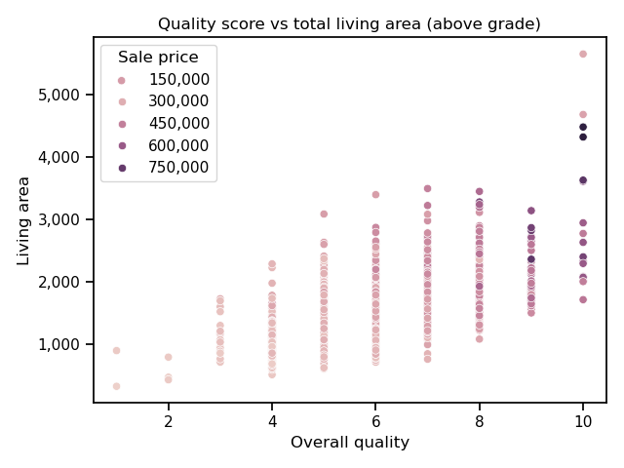
Feature surprises: overall quality vs area
Our two most important features have an interesting correlation.
Homes above a certain size have narrower quality score ranges, until 10 is reached.
This suggests that evaluators score 10s differently than other categories; it may be more likely that they lump a house into the 10 category, instead of 8 or 9.

Slide 9
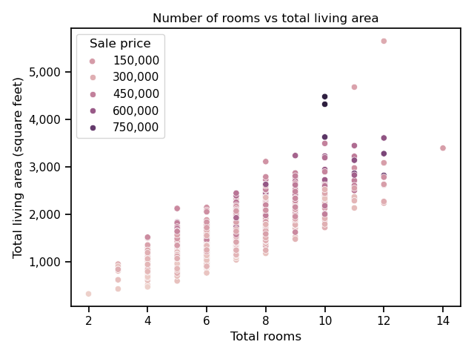
Feature surprises: rooms vs area
While size matters, there is a point of diminishing returns for both size and number of rooms.

Slide 10
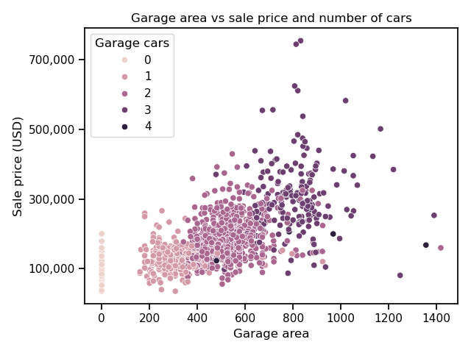
Feature surprises: garage area vs type
While garage size greatly influences sale price, there’s a wide range of sizes for each type of garage.
Some figures (such as the 500sqft, 4-car garage) seem improbable and are likely errors.

Slide 11
Feature surprise takeaways
The variables have generally predictable but imperfect and occasionally surprising relationships.
This suggests an ensemble model, such as gradient boost, may be best able to capture the points-of-no-return and rating biases.

Slide 12
Pre-Preparation Process
Full dataset (1,460 x 79)
Dataset with droppable nulls removed (1,389 x 79)
Continuous features
(1,389 x 33)
Ordinal features
(1,389 x 20)
Categorical features
(1,389 x 26)
Impute to zero (23)
Impute to median (3)
Impute to mode (7)
Change from str to int
Impute to “Other” (4)
Impute to “NA” (4)
Impute to “Norm” (1)
Impute to mode (14)
Impute to zero (6)
Impute to median (1)
Impute to mode (13)
Scale (mean=0, STD=1)
Select 10 most important
One-hot
Encode
(102 cols)
Scale (mean=0, STD=1)
Select 11 most important
Modeling set
(1,389 x 113)

Slide 13
Modeling process
- Given the nature of the problem described earlier, I expected gradient
boosting or random forest to yield the best results.
- I also included a Lasso model as a sanity check.
- Each model went through the following process:
Model Type
Default Parameters
Bayesian Optimized Parameters
Run on 30 randomized train/test splits
Check avg model metrics
Check avg model metrics

Slide 14
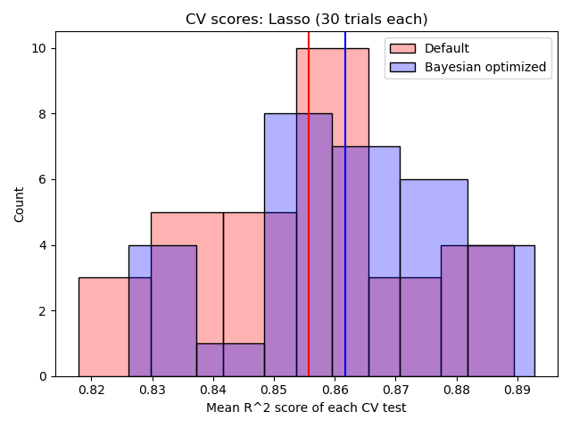
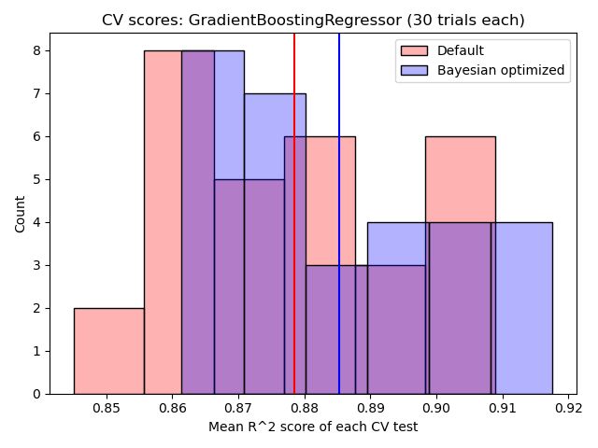
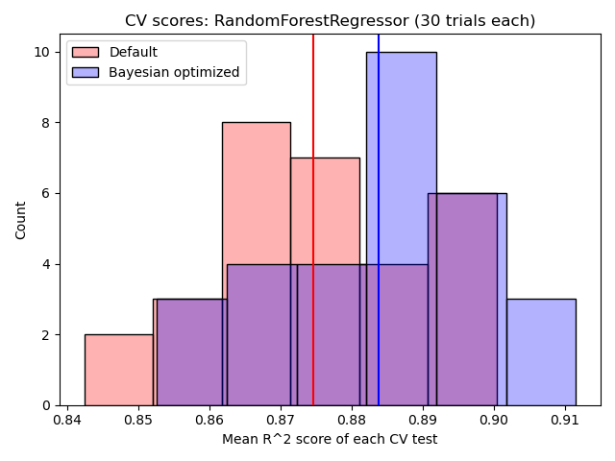
Model type performances
Mean Lasso R² score: .866
Mean GB R² score: .885
Mean RF R² score: .884
Since the mean GB and RF scores were comparable, I ran a t-test to see if the difference was possibly due to chance and got a p-value of 0.72.
Thus, I am not confident that GB or RF is consistently more accurate than the other.

Slide 15
Winning model parameters and metrics (GB)
Optimal parameters (Bayesian optimized):
'learning_rate’: 0.0249
'max_depth’: 10
'min_samples_leaf’: 5
'min_samples_split': 12
'n_estimators’: 291
'subsample’: 0.2108
Performance metrics:
R² score: 0.885
Explained variance: 0.885
Mean squared log error: 0.020
Mean squared error (USD²): 452,431,840.99
Mean absolute error (USD): 15,260.78

Slide 16
Limitations
The model’s applicability to real-life situations suffers from the following:
- Generalizability
The data is limited to a small location that is not representative of the country.
- Relevance
The data comes from a narrow range of years over a decade ago.
- Reliability
The data contains some clear errors, and the collection process is not transparent.

Slide 17
Future improvements
- Improved feature engineering
More in-depth exploration of feature selection and creation could yield better results.
- Expert consultation
Specific domain expertise could offer useful insights.
- Model combination
Employing different models and combining the results may reduce error.

Slide 18
Thank you!
Joshua Ogden-Davis
Springboard Data Science Track
June 2023 Cohort
Capstone Project

